Slide 1
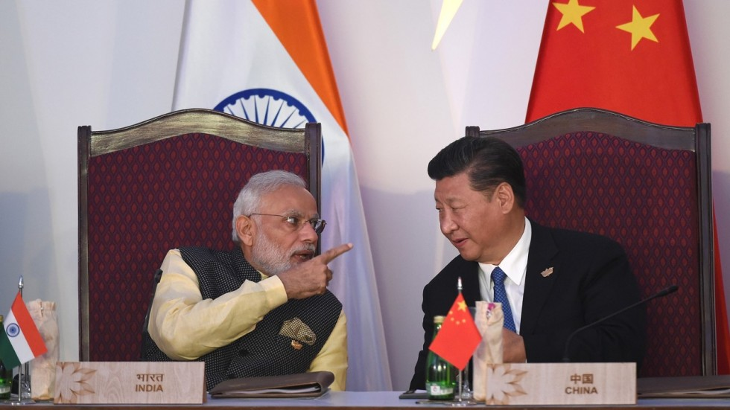
Rising Powers
Dr Jonathan Leader Maynard
jonathan.leader_maynard@kcl.ac.uk
www.jleadermaynard.com @jleadermaynard

Slide 2
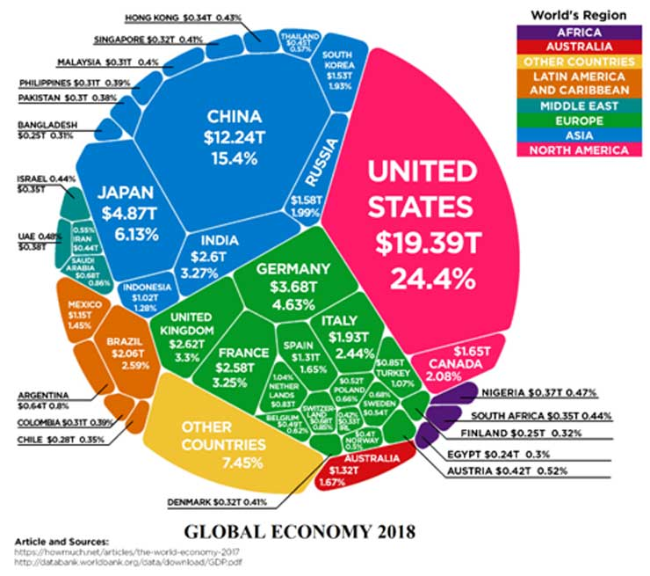
Power and Polarity in IR
Notes:
Diagram from: https://moderndiplomacy.eu/2019/09/03/reassessing-realities-of-a-multi-polar-world-order/

Slide 3
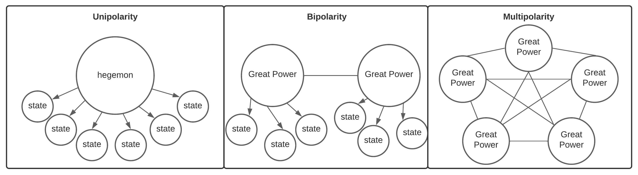
International Polarity
Realists generally assume that bipolarity diminishes instability and conflict, unipolarity may diminish instability and conflict, but is generally temporary, and multipolarity promotes instability and conflict.
‘Hegemonic Stability Theory’ however (which mixes some realist and liberal ideas), would contend that unipolarity can be sustained and stable.
Liberals generally highlights how effective institutions might moderate conflict between great powers/states.

Slide 4
The Rise of the BRICS
Brazil, Russia, India, China and (since 2010) South Africa
All have evident economic clout and structural power (e.g., via UN and development banks)
But it is questionable as to whether they represent a joint category (Pant, Armijo)

Slide 5
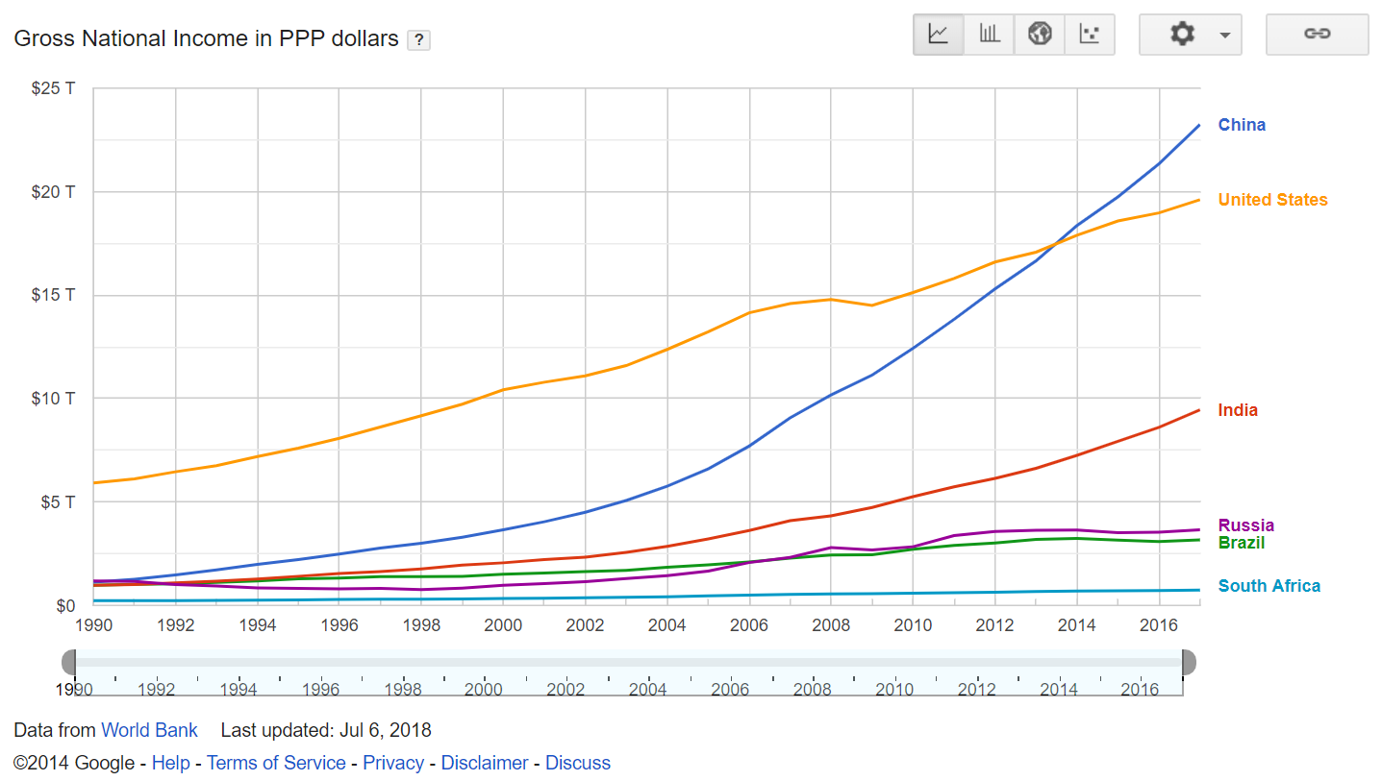
Strongest case for the rising power of BRICS centres on China and India. Weak Russian economy is, however, supplemented by large military hardware and extensive energy resources (on which Europe depends).
PPP measures GNI as if exchange rates don’t matter – measuring at exchange rates would reduce BRICS’ GNI.

Slide 6

But what is power?
Max Weber: “the probability that an actor in a social relationship will be in a position to carry out his own will despite resistance, regardless of the basis on which this probability rests.”
Robert Dahl: “A has power over B to the extent that he can get B to do something that B would not otherwise do.”
Hard vs Soft Power? (Nye)
The ‘three faces of power’: i) ability to prevail over resistance (Weber/Dahl); ii) ability to control the agenda (Bachrach and Baratz); iii) ability to shape desires and beliefs of others (Lukes).
Notes:
Figure from Michael Beckley, ‘The Power of Nations: Measuring What Matters,’ International Security 43/2 (2018), p.25

Slide 7
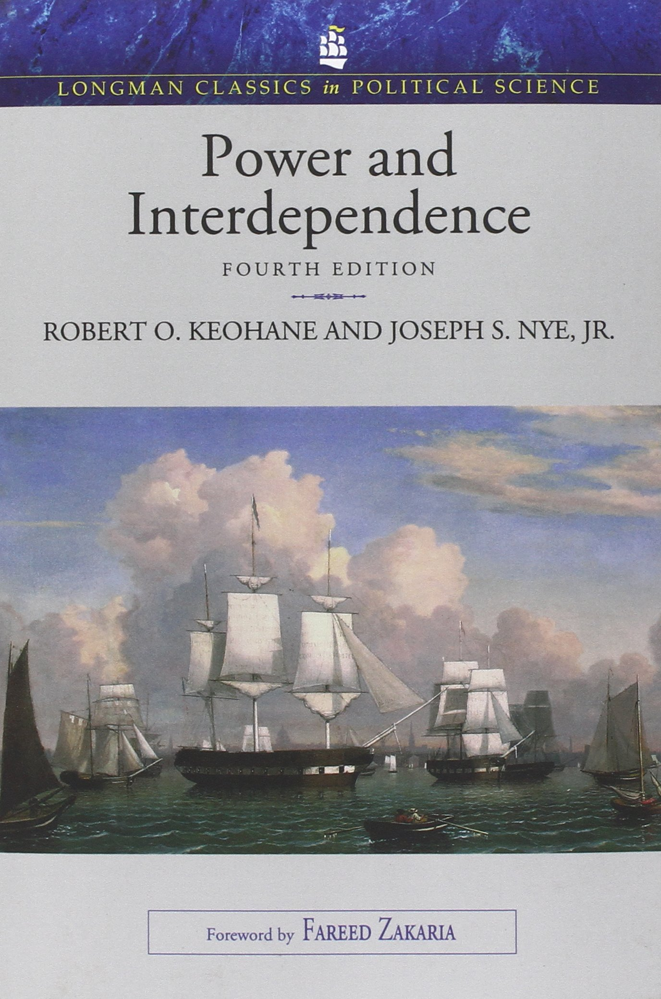
Complexities of Power
How fungible vs. issue-dependent is power? – e.g. EU’s power in trade negotiations vs. US power in armed conflict.
Power may be affected by sensitivities (extent to which changes in one state affect policies in another within one policy framework) and vulnerabilities (the lack of alternative available policy frameworks should existing framework become too costly).
Difference between lump sum power (the various resources a state has) and realised power (the ability to shape outcomes). Latter is more relevant but harder to measure/establish.
So how can we measure power?

Slide 8
Measuring US, Chinese and Russian Power?
 | USA | Russia | China
Total GDP | $20.8tn (1st) | $1.4tn (11th) | $14.7tn (2nd)
Nuclear Warheads | 5,550 (2nd) | 6,257 (1st) | 350 (3rd)
Active Armed Services | 1,390,000 (3rd) | 850,000 (5th) | 2,000,000 (1st)
Tanks | 6,612 (2nd) | 12,420 (1st) | 5,250 (4th)
Defence Budget | $770bn (1st) | $154bn (3rd) | $250bn (2nd)
Military Aircraft | 13,247 (1st) | 4,173 (2nd) | 3,285 (3rd)
Military Vessels | 484 (3rd) | 605 (2nd) | 777 (1st)
CINC | 0.133 (2nd) | 0.036 (4th) | 0.230 (1st)
Notes:
Figures from:
https://data.worldbank.org/indicator/NY.GDP.MKTP.CD?most_recent_value_desc=true
https://www.armscontrol.org/factsheets/Nuclearweaponswhohaswhat
Globalfirepower.com

Slide 9
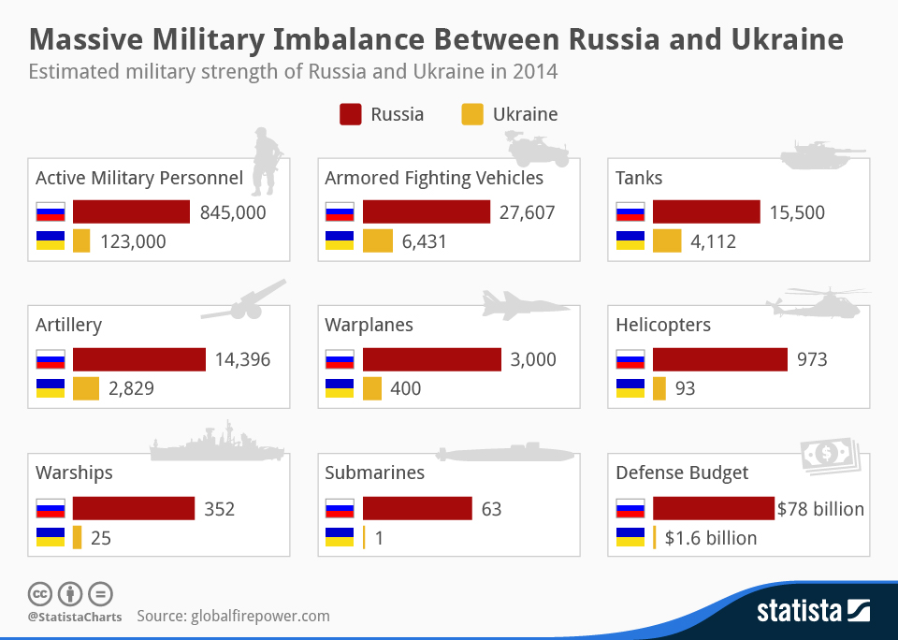
The Limits of Conventional Power?

Slide 10
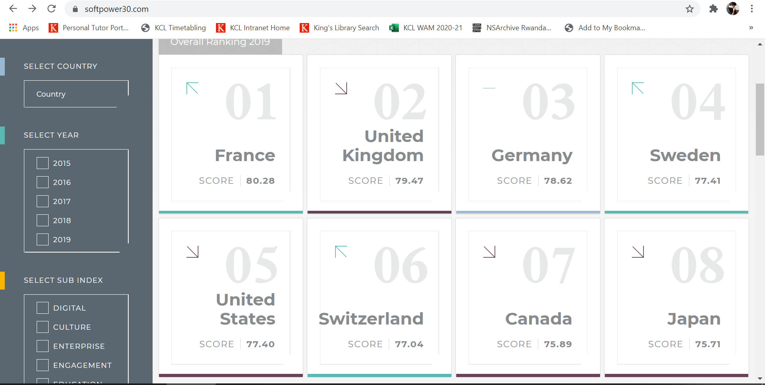
Measuring Soft Power?

Slide 11
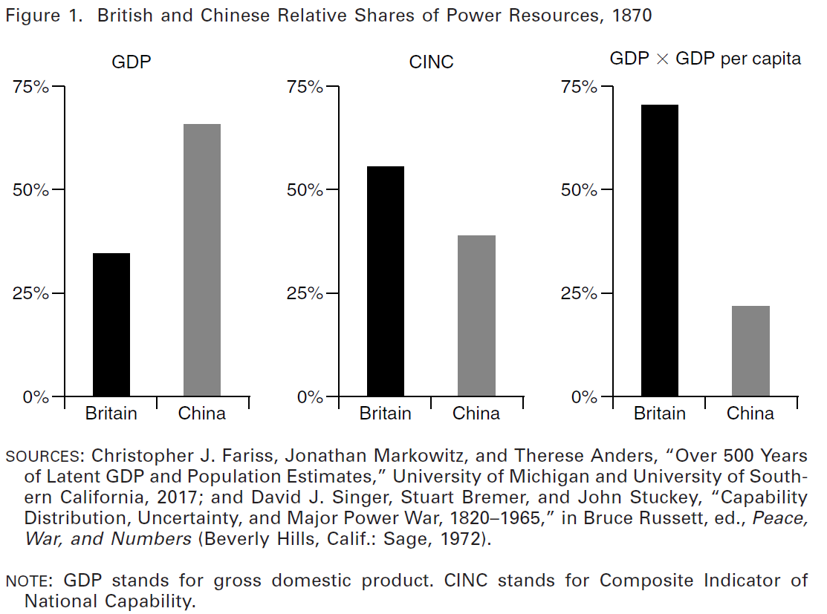
Michael Beckley: Total GDP measures gross economic output, not the net economic output that could be mobilised by governments. A good proxy is to calculate GDP x GDP per capita.
Notes:
Figure from Michael Beckley, ‘The Power of Nations: Measuring What Matters,’ International Security 43/2 (2018), p.25

Slide 12
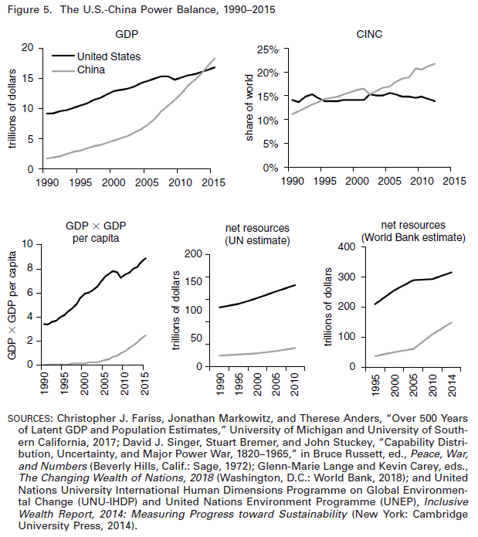
The ‘Primacist’ Counterargument
Despite size of Chinese economy, China has huge running costs and little spare capacity, so pure GDP massively inflates China’s apparent power (Beckley).
America retains effective “command of the commons” – control of unowned land, sea and space through huge naval and aerial military dominance (Barry Posen)
Systemic constraints on US power are largely inoperative – states are not balancing against the US, US can largely ignore institutional constraints, and US dominates economic relationships with others (Stephen Brooks and William Wohlforth).
US hegemony is perceived as relatively benign and mutually beneficial by most of the world (John Ikenberry)
Notes:
Figure from Michael Beckley, ‘The Power of Nations: Measuring What Matters,’ International Security 43/2 (2018), p.43

Slide 13
Major hurdles for rising powers
The ‘middle-income trap’: loss of advantage of very cheap labour + continued technologically disadvantaged relative to high-income states = struggle to sustain strong economic growth
Entrenched technological advantages for wealthiest states in telecommunications, defence industries, space technology which cannot easily be replicated.
Institutional Advantages for Existing Great Powers: e.g. UN Security Council vetoes (although Russia and China do have them), influence in IMF and World Bank, G7 membership etc.
Authoritarian Institutions amongst several rising powers may be an advantage in the medium run, but disadvantages in the long run.

Slide 14
Is balancing against the US occurring?
And if not, why not?
Conventional balancing can take two forms: external balancing (forming alliances with other states) or internal balancing (building up your state’s own power through, e.g. military spending).
Conventional balancing against the USA doesn’t seem to be occurring (until Feb 2022 China-Russia Beijiing Communique)?
Many rising powers may instead be bandwagoning – aligning themselves with the US.
But other scholars suggest that states might be balancing against the US by less direct means, e.g.:
‘Soft balancing’ (Robert Pape) – “measures that do not directly challenge U.S. military preponderance but use international institutions, economic statecraft, and diplomatic arrangements to delay, frustrate, and undermine U.S. policies”.
‘Pre-balancing’ – building up core economic foundations of power without yet turning to more threatening military build-up.
Notes:
Pape quote from: Robert A. Pape, ‘Soft balancing against the United States,’ International Security 30/1 (2005), pp. 7-45.

